Slide 1
Illustrated Word Drawing
Intro to Art, Fall 2017, Mrs. Rizzo
Unit 3

Slide 2
Standards and Vocab:
VA:Cr1.1.HSI
Use multiple approaches to begin creative endeavors.
VA:Cr1.2.HSI
Shape an artistic investigation of an aspect of present-day life using a contemporary practice of art or design.
Typography, Illustrator/Illustration, Elements of art, Noun, Verb, Adjective, Descriptive word

Slide 3
What is my learning target today?
What am I going to do to hit the target?
How will I SHOW I have hit the learning target?
To understand typography and design and think like an Illustrator
Engage in PowerPoint; Identify noun/verb/adjective for creation of illustrated word
You will SHOW your understanding of typography and illustration by expressing ideas for the descriptive word through creating four, separate thumbnail sketches

Slide 4
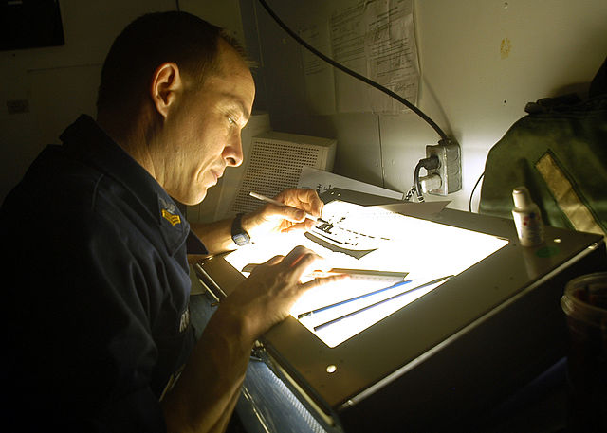
What is an Illustrator?
An illustrator is a type of artist who may work for the media arts, such as magazines, newspapers, books, and other companies where visual art effects are needed
Illustrators work in the field of advertising – companies depend on the creativity of illustrators to attract the potential clients’ attention (you!)

Slide 5
Typography and Illustration
Illustrators study and use Typography in their work, or the formatting of a visual layout for lettering (font, size, shape!) to successfully convey a message to the viewer

Slide 6
Assignment due Fri. Dec. 8th!
Create one, illustrated word and illustrate by making the word LOOK LIKE what it says
Start with four sketches/four different words in sketchbook, and prepare to move on to final paper and final illustrated word imagery!
Ask yourself: “How can I make this word look like what it says?”

Slide 7
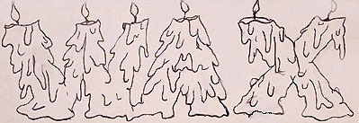
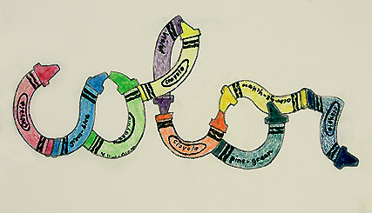
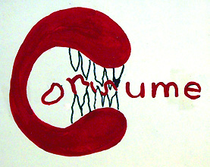
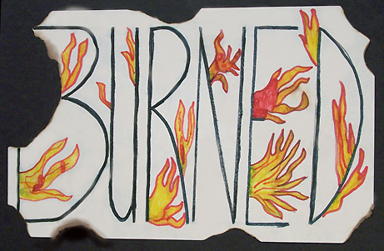

Slide 8
Works Cited
http://www.kid-at-art.com/icons/crayon.jpg
http://www.kid-at-art.com/htdoc/lesson70.htm
http://www.kid-at-art.com/icons/consume.jpg
http://www.kid-at-art.com/icons/burned.jpg
http://www.kid-at-art.com/icons/wax.jpg

